Slide 1
Rats N’ Cats
Pac-Man Inspired Video Game
By Emaan Jivani & Hebat Elkacemi
EECE 2140: Computing Fundamentals

Slide 2
Table of Contents
01
02
Introduction
Game Demo
03
04
Literature Review
Methodology
Objectives/Goals
& Project Scope
Summary & Previous Related Works
Methods, Data Structure
& Pseudocode
Interpretations, Findings & Methods

Slide 3
Table of Contents Cont.
05
06
Analysis
Discussion
07
08
Conclusion
References
Project Limitations & Implications
Conclusions & Improvements
Demo of Completed Game
List of Cited Sources & Other Resources

Slide 4
Introduction
Objectives and Goals:
Create a Pac-Man-inspired game with a "Rats N’ Cats" theme.
Replace traditional pellets with cheese and ghosts with cats.
Implement unique features such as mouse progression (chomping effect) and power-ups.
Project Scope:
Design a custom maze, characters, and game rules.
Improve collision detection by creating a transparent ring around the rat, to enhance the precision of interactions with walls and cats.
Notes:
hebat

Slide 5
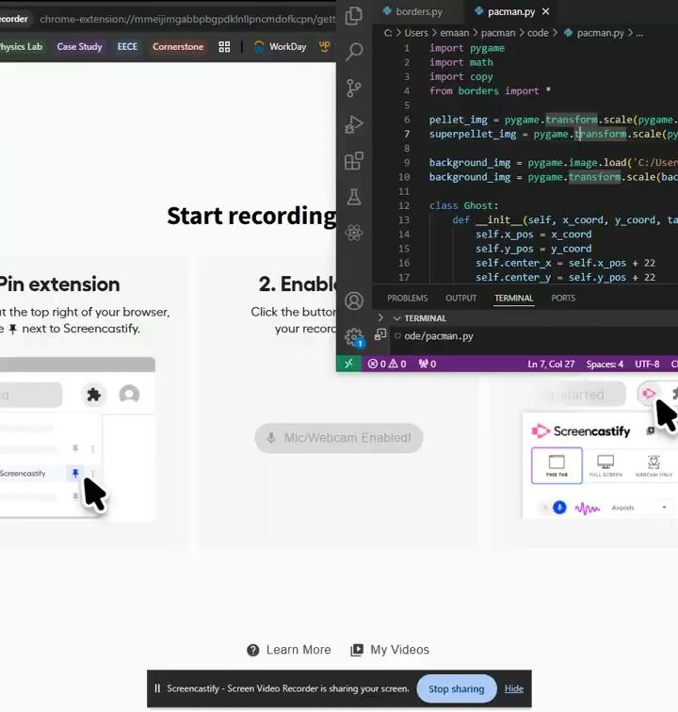
Game
Demo
Notes:
Emaan

Slide 6
Literature Review
Summary of Relevant Existing Work:
Original Pac-Man mechanics (maze, pellets, ghost, power ups).
Key gameplay features like scoring based on pellets eaten and power-ups granting temporary invulnerability.
Relation to Project:
Introduced a theme-based twist: Rats N’ Cats (new visuals).
Reimagined gameplay mechanics (e.g., apple as power-ups).
Notes:
hebat

Slide 7
Game Development Methodology
Planning:
Tasks were divided evenly among team members, such as the coding, character design, and animations
Techniques Used:
Used GUI Pygame for rendering sprites, managing inputs, detecting collisions, scoring, and integrating Python logic with hand-drawn visuals.
Data Structures Utilized:
Lists track positions; dictionaries manage states like power-ups.
Notes:
Emaan

Slide 8
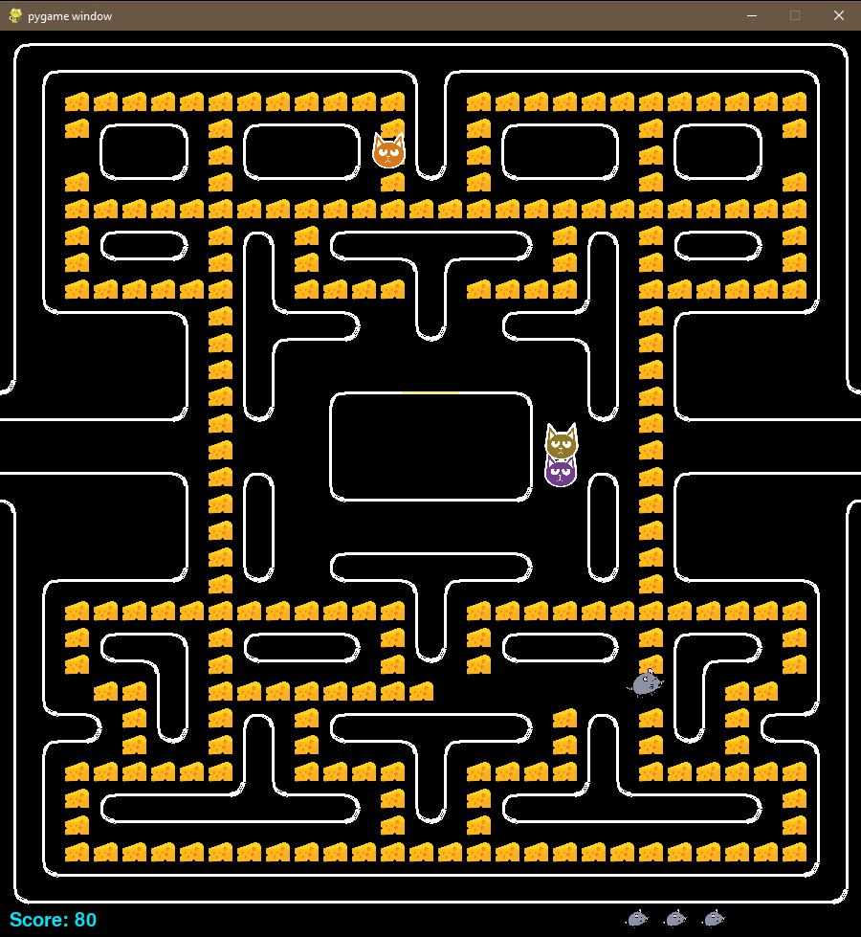


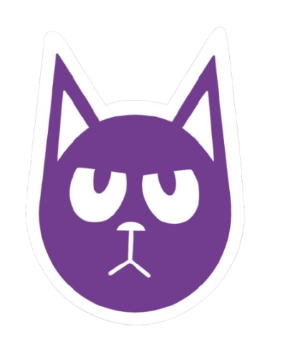
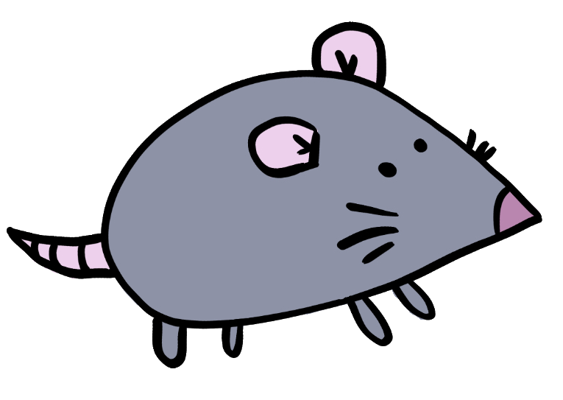
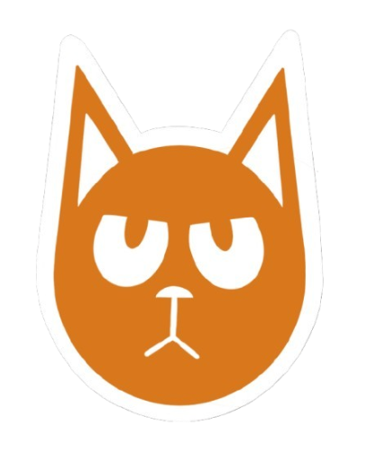
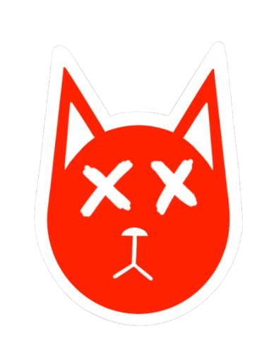
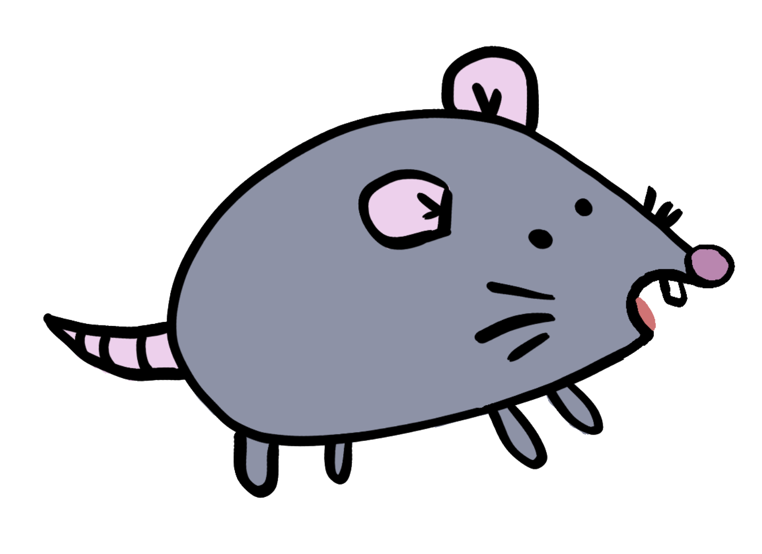

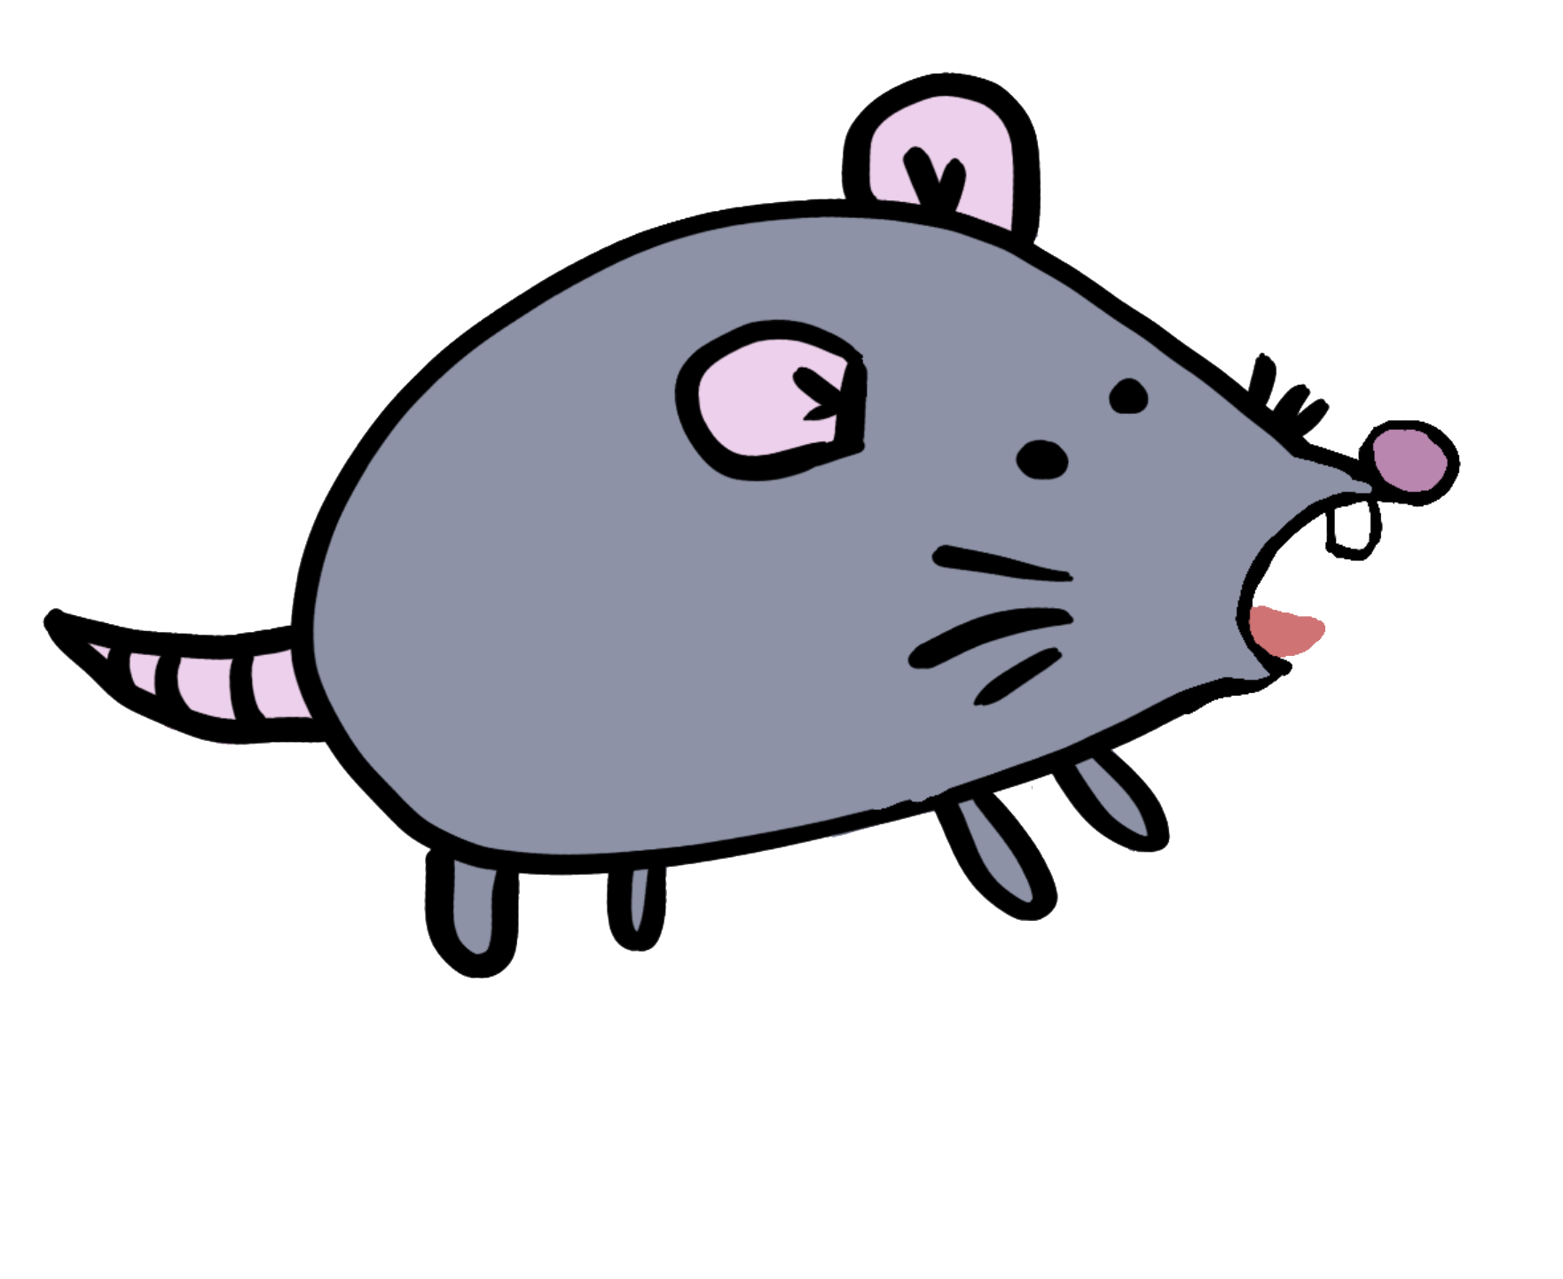

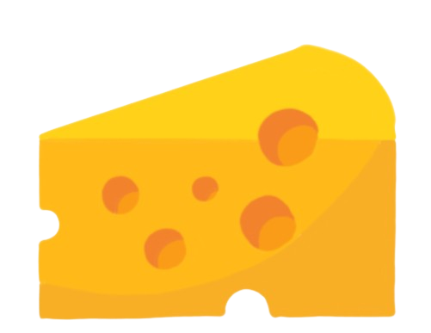
Visuals/Pseudocode
Notes:
Emaan

Slide 9
Pseudocode Pt 1
Initialize pygame, screen dimensions, clock, and fonts
Load assets (images, fonts) and level data (borders)
Set constants and variables (player/cat positions, directions, scores, powerups, etc.)
Define `Cat` class:
- Initialize position, speed, state, and target
- Draw the cat and return its rectangle
- Check collisions with walls and determine valid directions
- Define movement behaviors for each cat (e.g., orange, purple, etc.)
Notes:
emaan

Slide 10
Pseudocode Pt 2
Define utility functions:
- draw_others(): Draw score, lives, and game state messages
- check_collisions(): Handle collisions with “cheese” and power-ups
- draw_borders(): Render pellets, walls, and superpellets
- draw_player(): Draw player sprite based on direction
- check_position(): Determine valid player movement directions
- move_player(): Move player based on current direction
- get_targets(): Calculate targets for each cat based on power-up state
Notes:
emaan

Slide 11
Pseudocode Pt 3
Main game loop:
- Clear screen and draw background
- Update flicker effect and power-up timer
- Render level borders, player, and cats
- Update player and cat positions
- Check collisions between player, cats, and objects
- Handle game-over and restart logic
- Process player inputs (arrow keys for movement, space for restart)
- Update display
End pygame when the game loop exit
Notes:
emaan

Slide 12
Project Analysis and Results
Time Spent:
4 hours per week (increased to 5-6 hours as deadline approached)
Analysis/Results:
The game was functional and similar to our inspiration (Success!)
We found that this game used AI game logic for an illusion of the modern artificial intelligence we know of today.
Collisions/ Fleeing movement
Targets
Direction adjustment
Notes:
hebat

Slide 13
Discussion
Implications of Findings:
Balancing creative visuals with functional code is key to maintaining smooth gameplay.
Thematic redesigns can help modernize classic games, offering new and fun experiences while maintaining core gameplay.
Project Limitations:
Limited time prevented full exploration of dynamic maze difficulty.
Optimization of game features was constrained by time.
Glitch in rat turning at times
Notes:
hebat

Slide 14
Conclusion
Key Learnings:
Blending art and code can effectively elevate the overall player experience.
Iterative development leads to a smoother, more polished game.
Future Recommendations:
Increase game difficulty by adding more cats as the rat gets closer, speeding up the cats, or making the game faster overall.
Add randomized one-time power ups for the Rat to catch which would “jail” one cat for a certain amount of time.
Enhance dynamic level progression to keep gameplay engaging
Notes:
hebat

Slide 15
References
https://youtu.be/KB0BHw7rnqU?si=SFhu3D7VDnoRB-Ju
(example of another project)
ChatGPT AI for debugging purposes
https://www.pygame.org/wiki/GettingStarted
(understand how to import pygame)
https://gamedev.stackexchange.com/questions/30866/collision-detection-with-non-rectangular-images
(how to detect collision using python and imported images)
Notes:
hebat

Slide 16
Thank You!
Questions?

